Slide 1
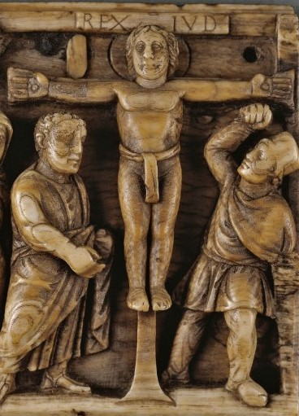
The Cross and the Crucifix in Art
St Gregory’s, Stratford 2025
Oliver Holt OSB

Slide 2
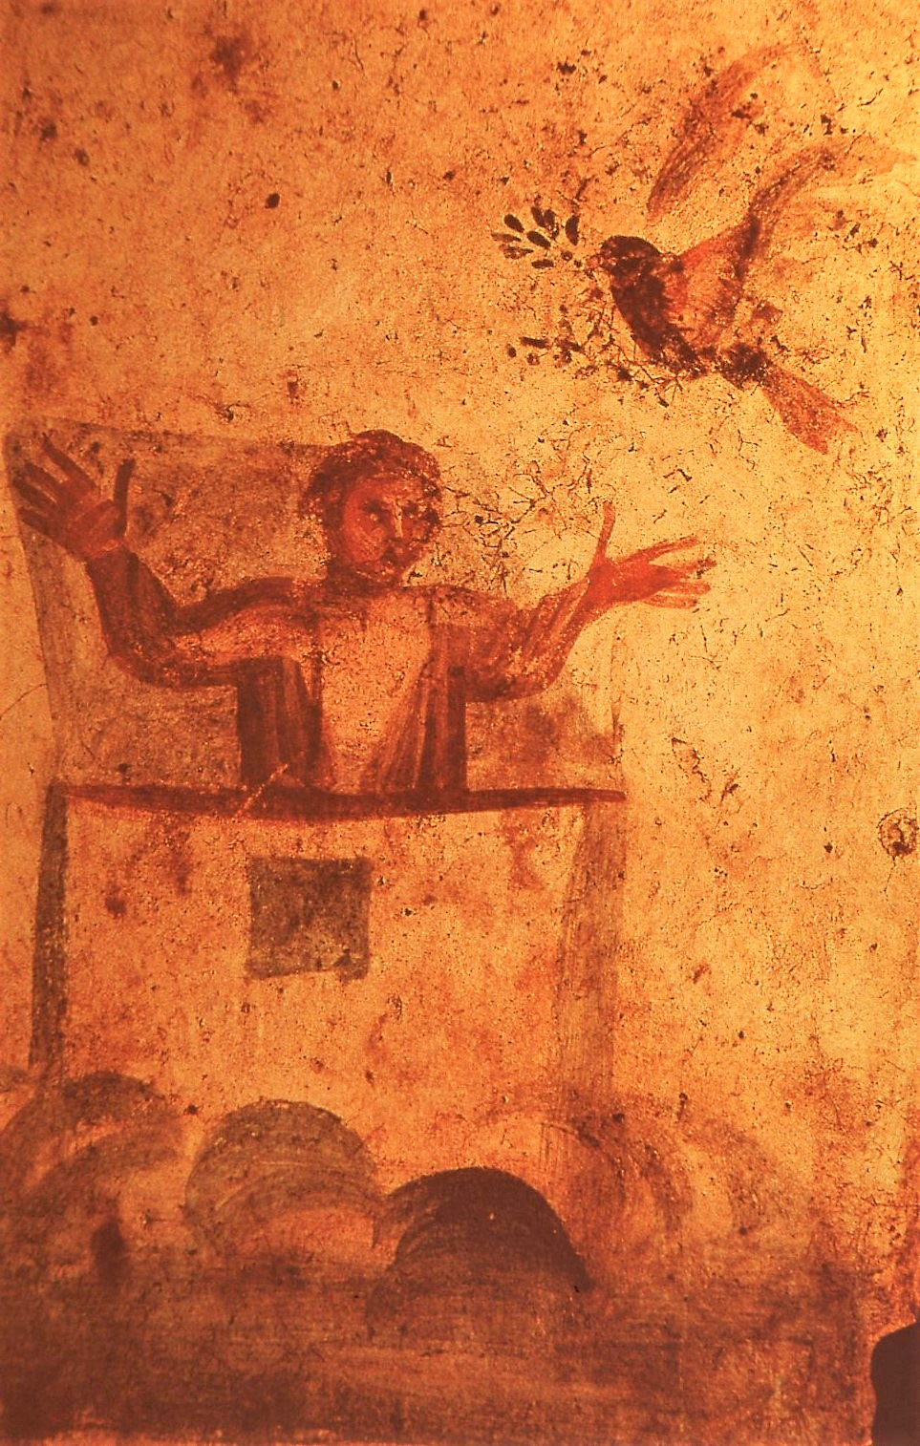
Noah & the Dove
Catacomb of
SS Peter & Marcellinus 4th century

Slide 3
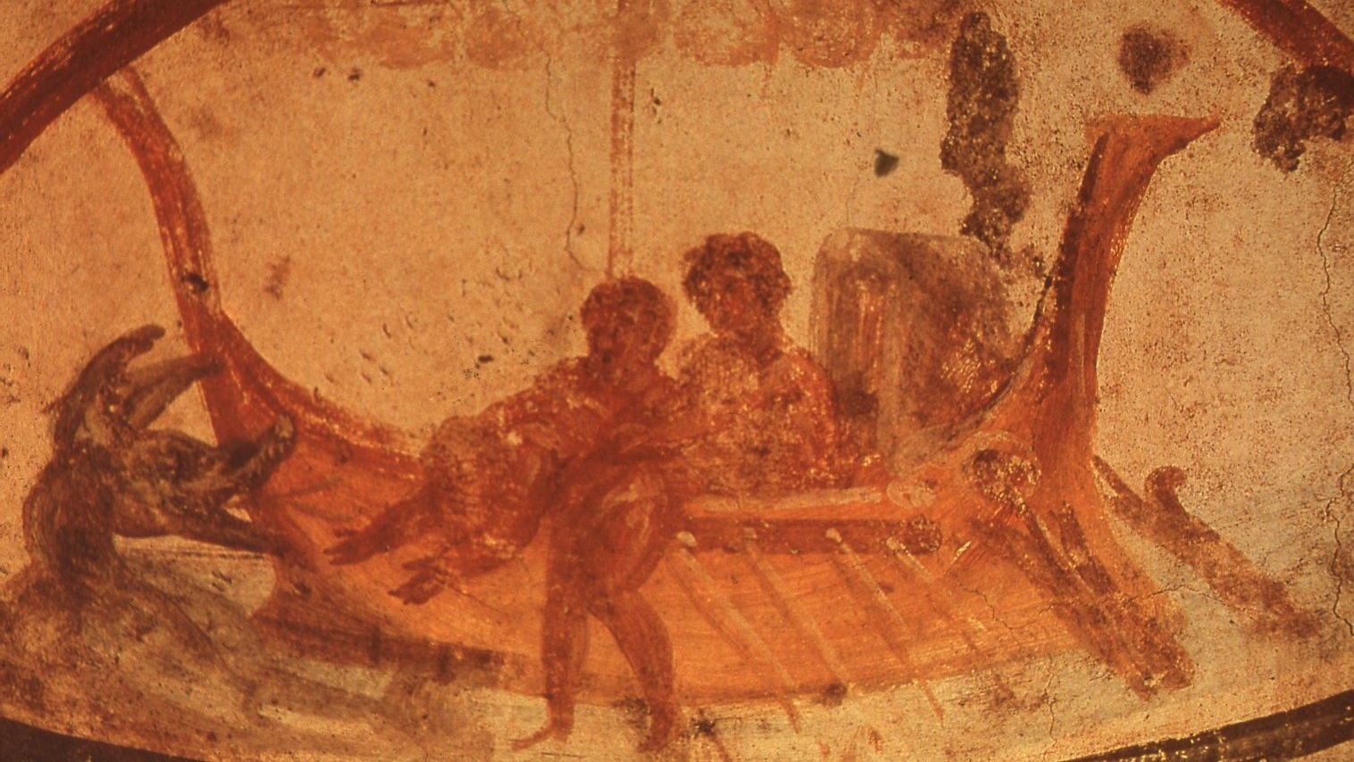
Jonah thrown into the sea - catacomb of SS Peter & Marcellinus 4th century

Slide 4
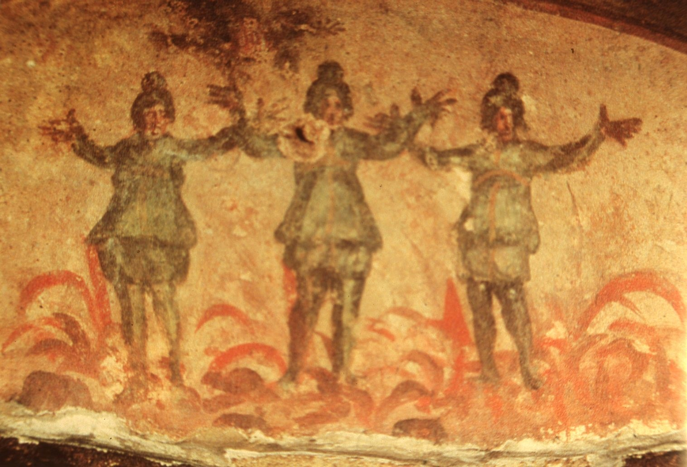
Three young men in the furnace - Catacomb of Priscilla 2nd - 4th century

Slide 5
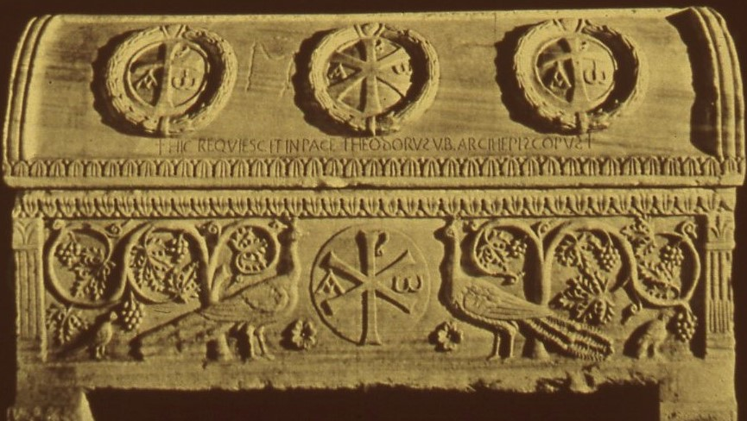
Roman sarcophagus
4th century

Slide 6
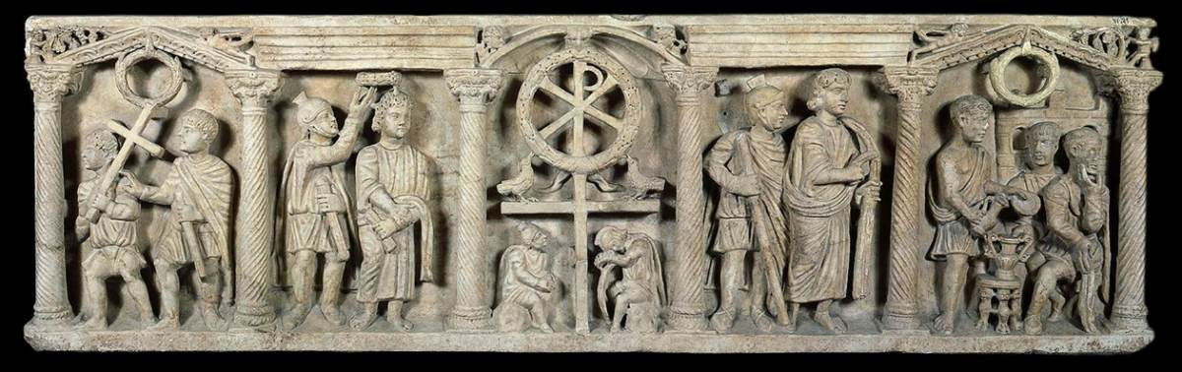
Roman Sarcophagus
4th Century
Vatican Museum

Slide 7
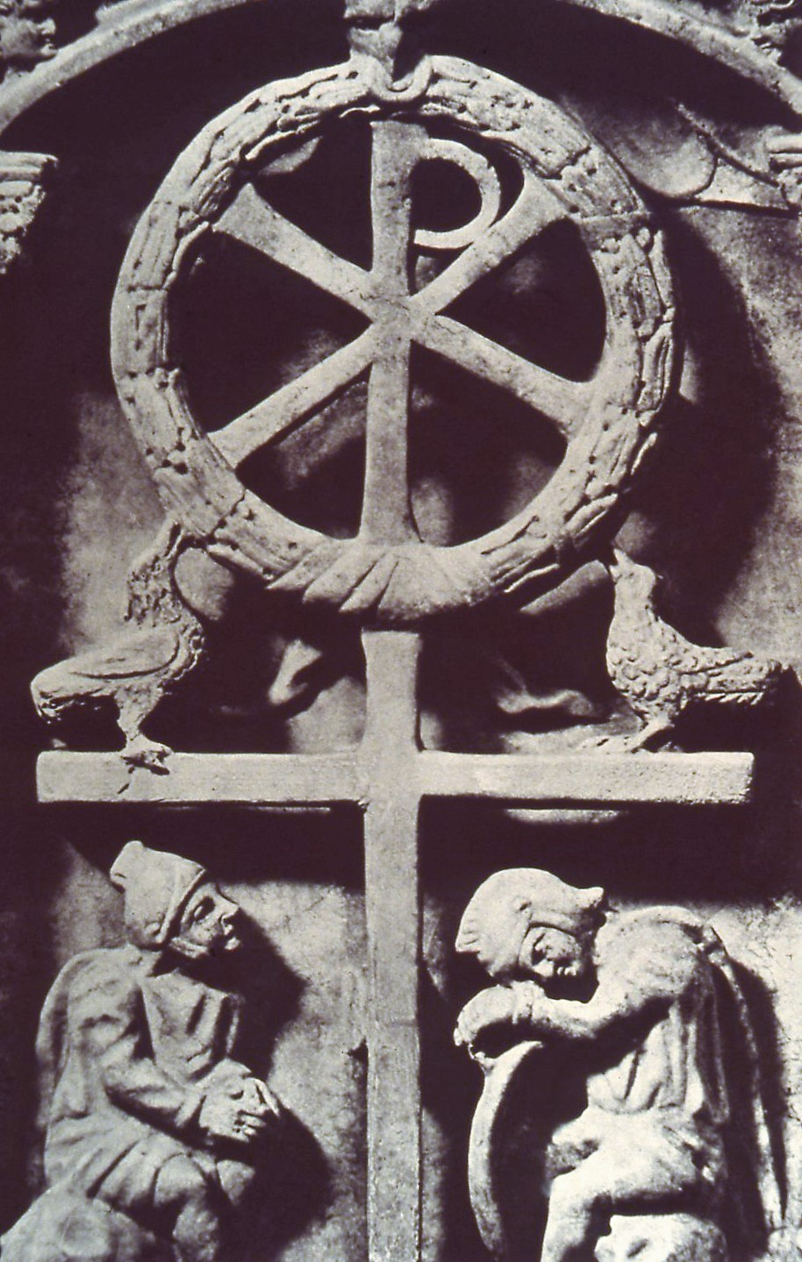
Roman sarcophagus - detail

Slide 8
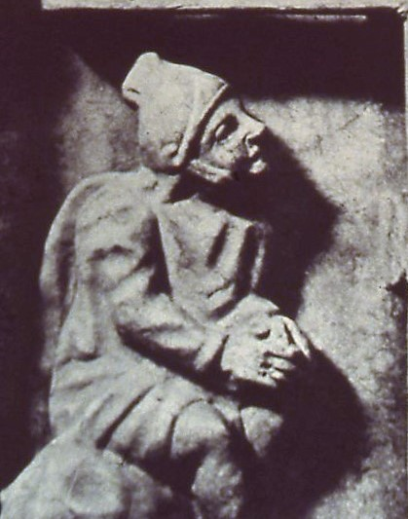
Roman sarcophagus
detail

Slide 9
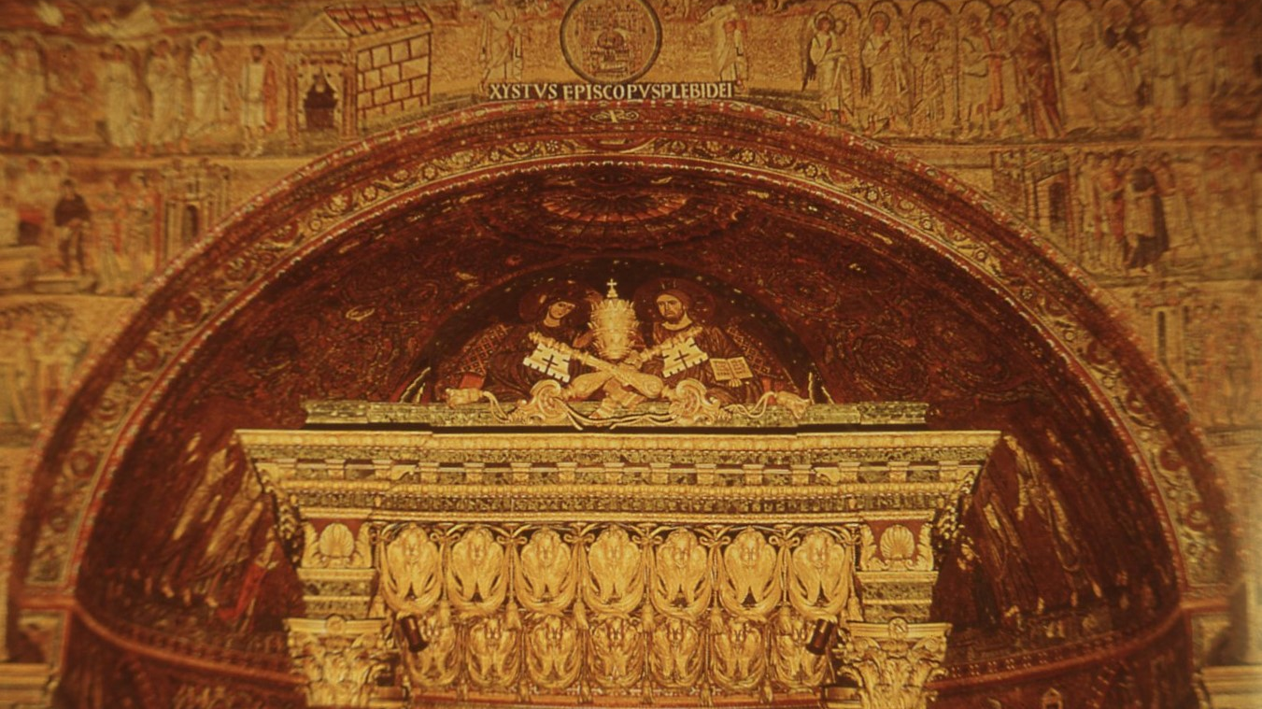
S Maria Maggiore, Rome
triumphal arch
5th century

Slide 10
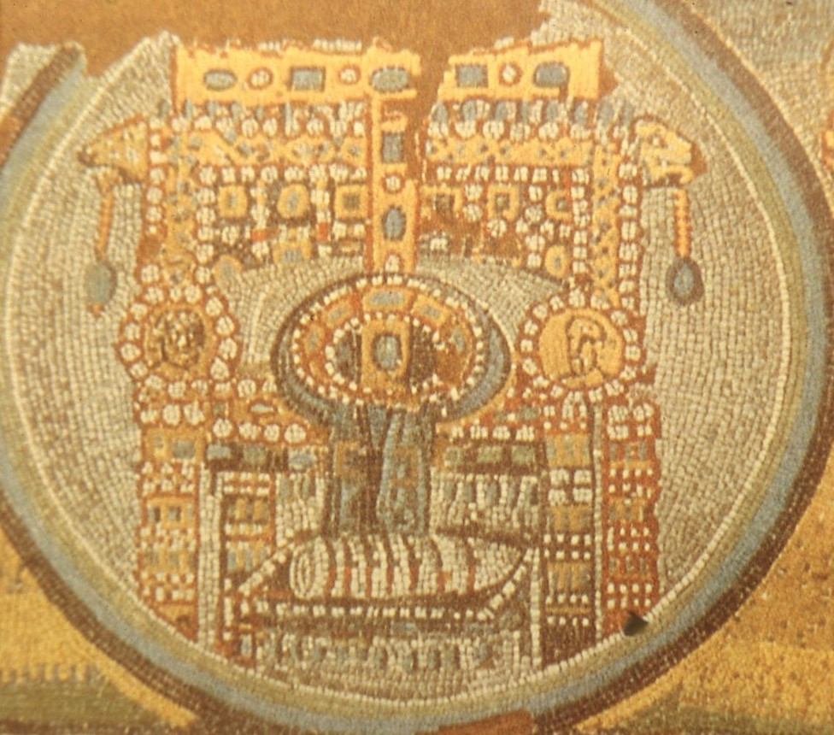
S Maria Maggiore (detail)
Enthroned Cross

Slide 11
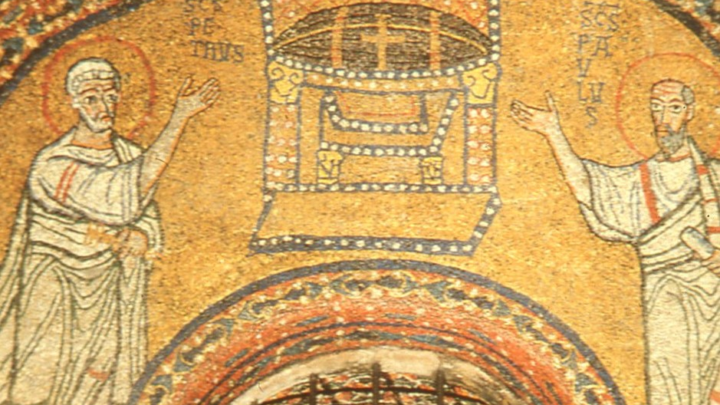
Church of St Praxedes Rome

Slide 12
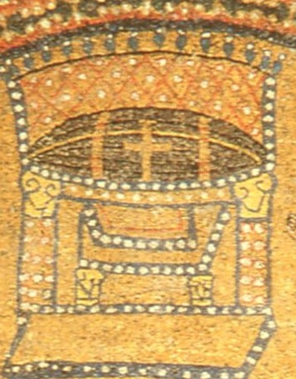
St Praxedes (detail)
Enthroned Cross

Slide 13
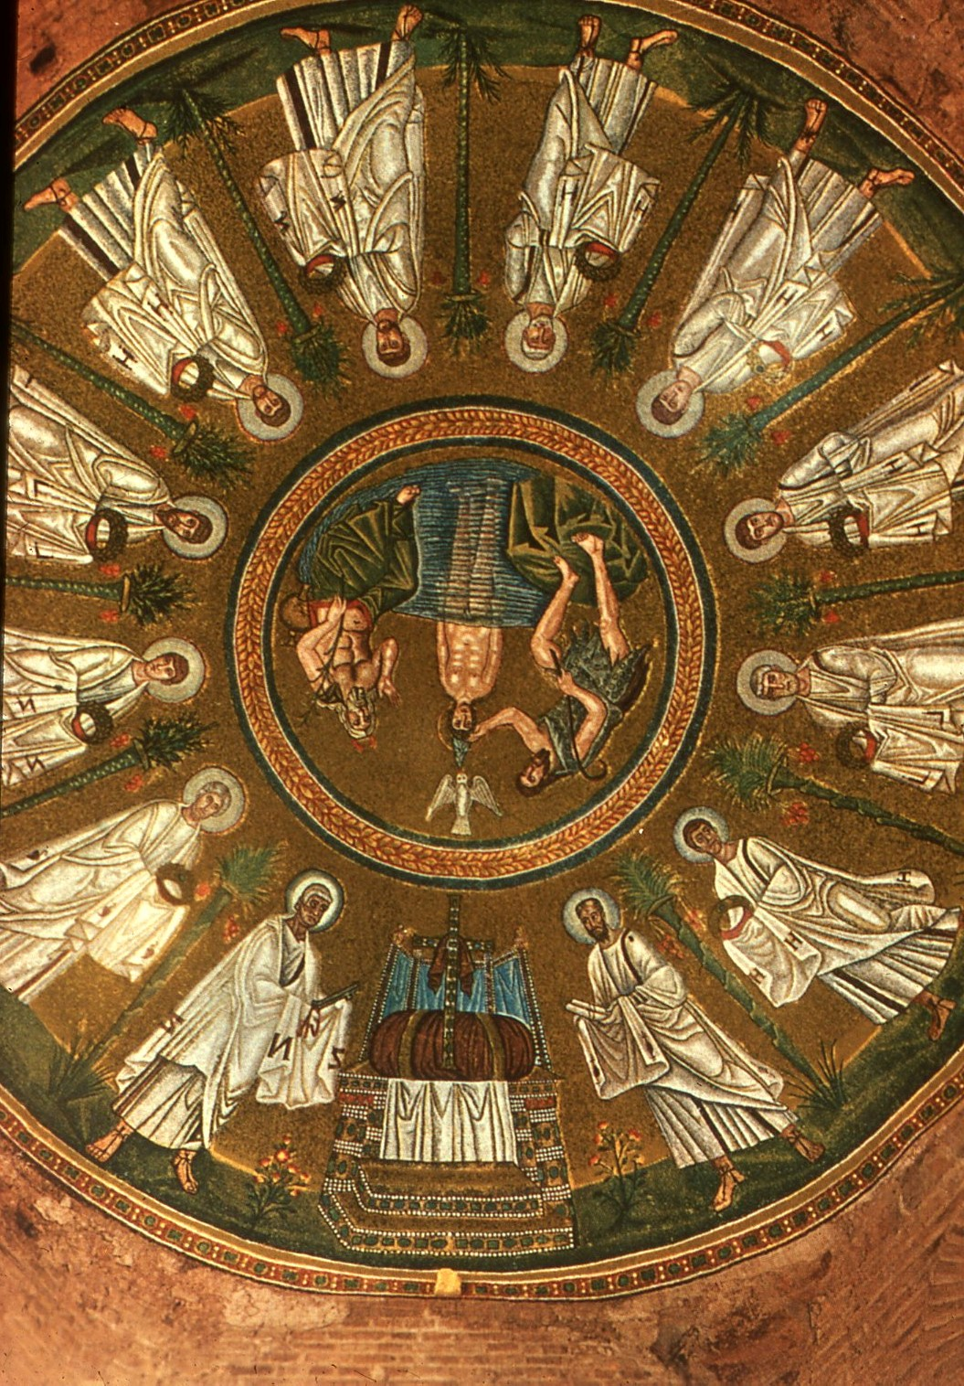
Arian Baptistery Ravenna
6th century

Slide 14
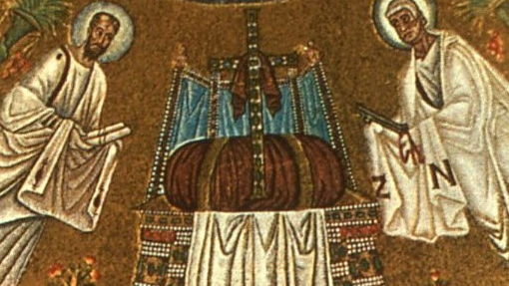
Arian baptistery (detail)
Enthroned Cross

Slide 15
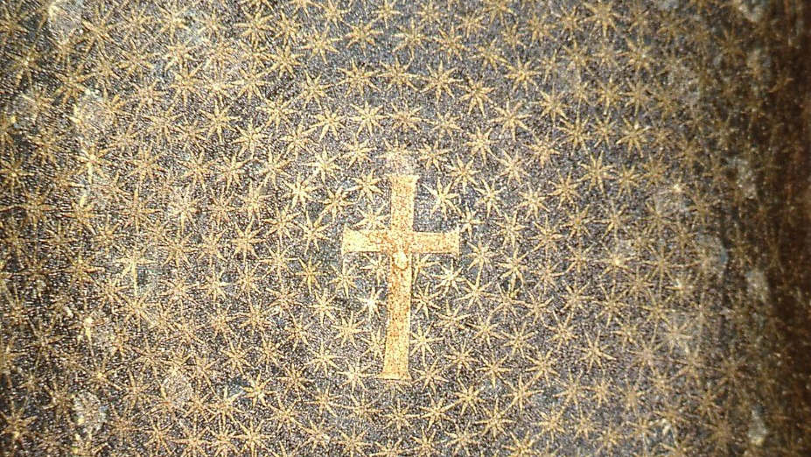
Mausoleum of Galla Placida, Ravenna 5th century

Slide 16
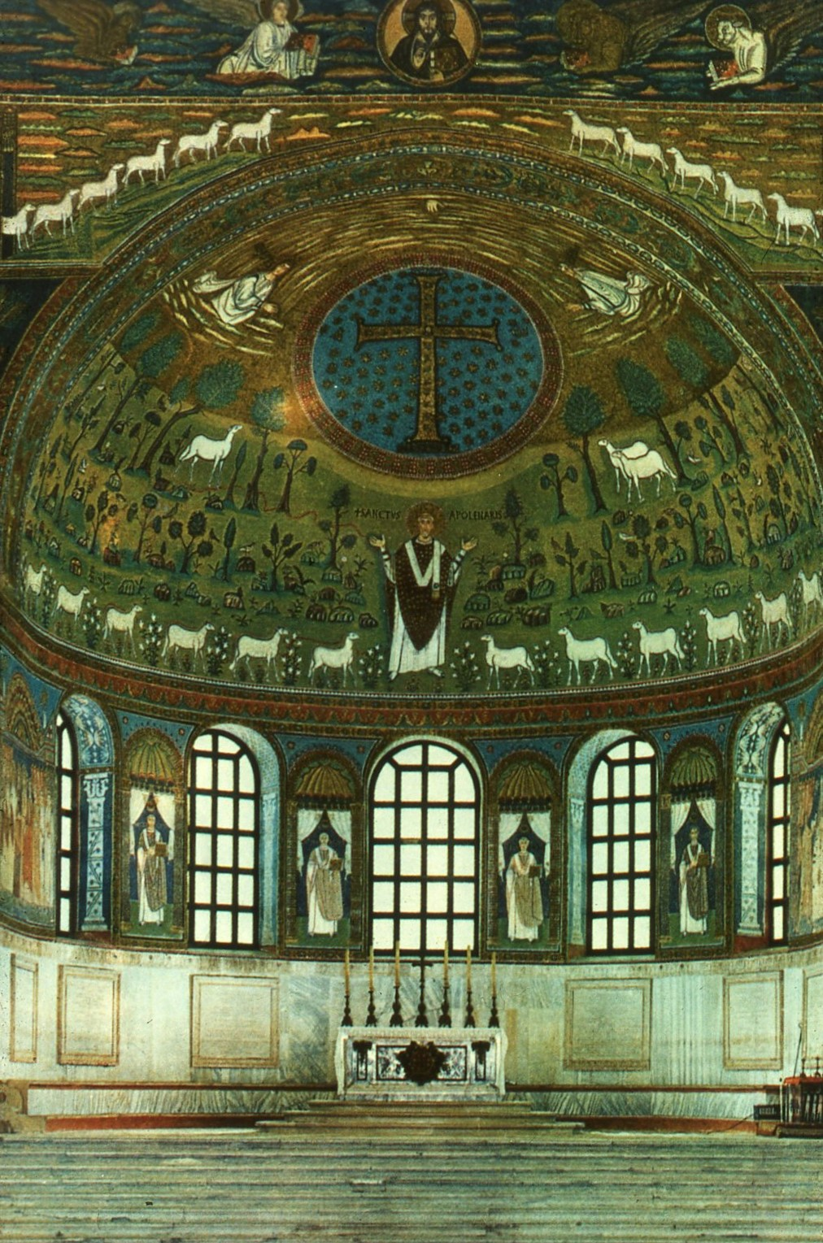
St Apollinare in Classe, Ravenna
6th century

Slide 17
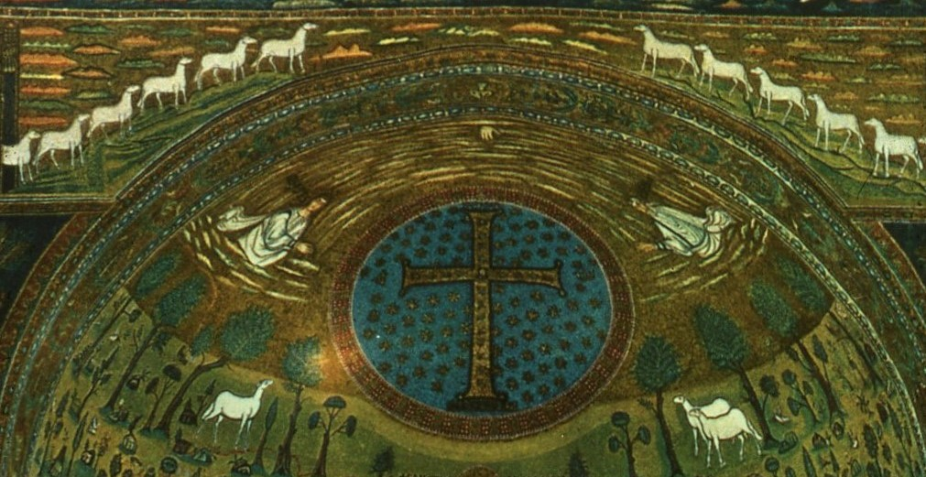

Slide 18
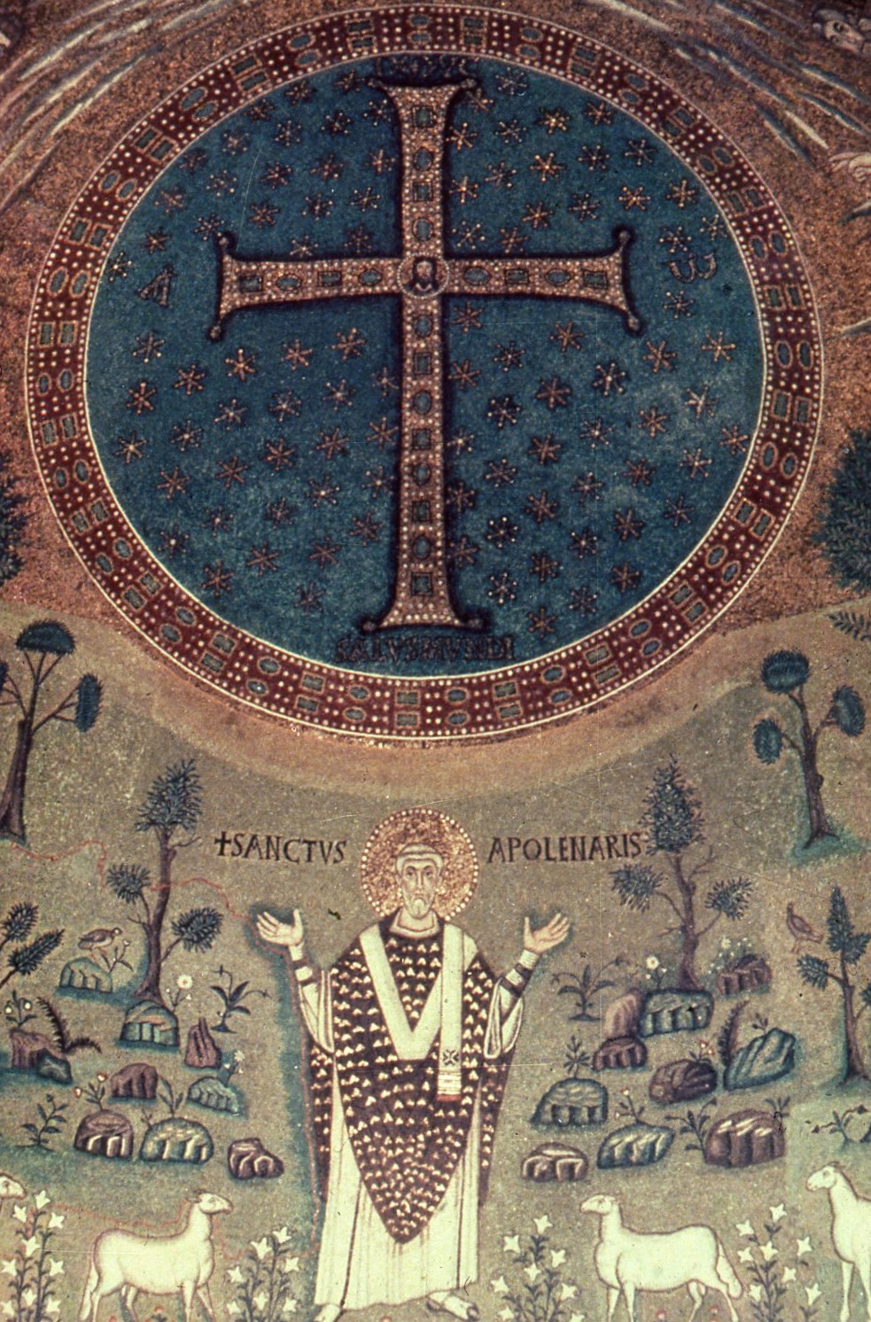

Slide 19
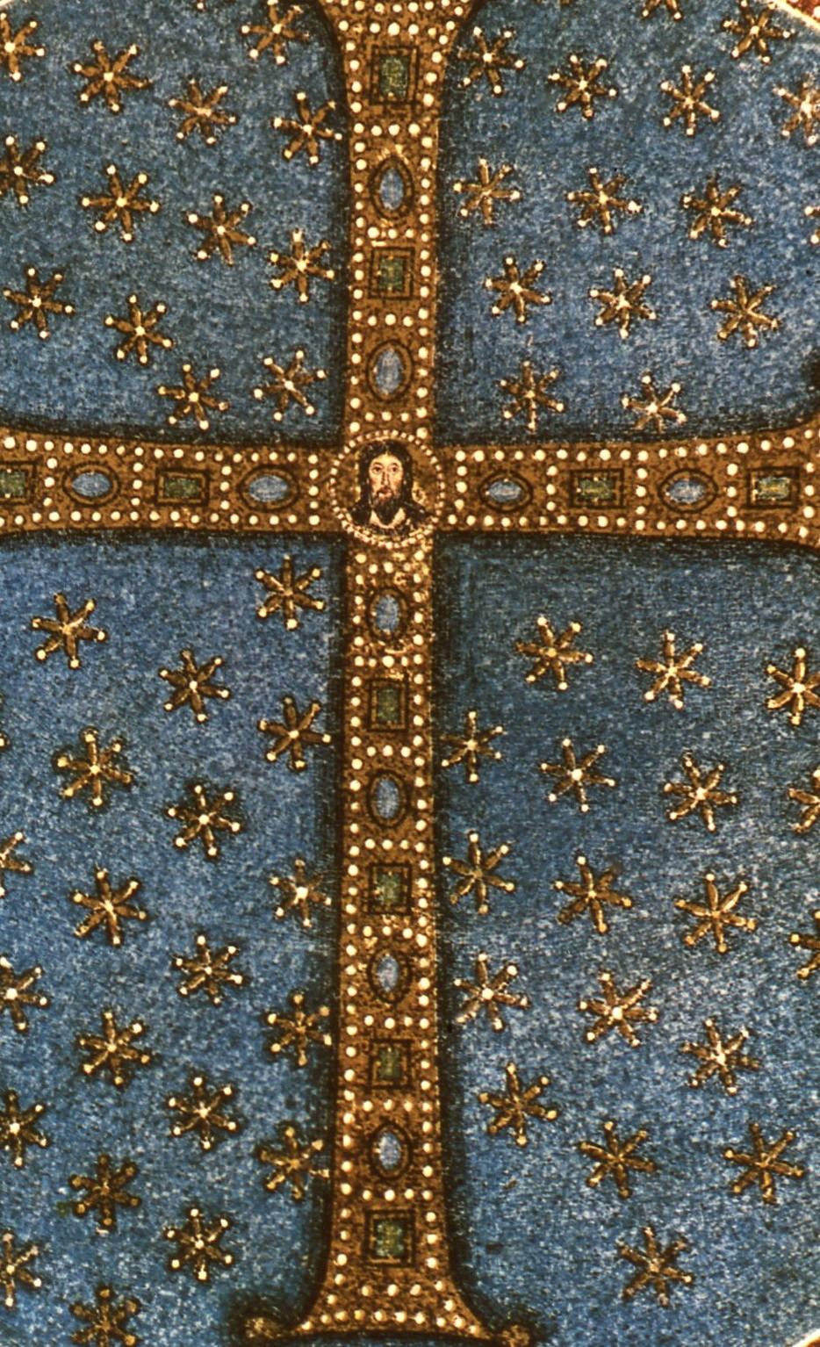
S Apollinare in Classe (detail)
Jewelled Cross

Slide 20
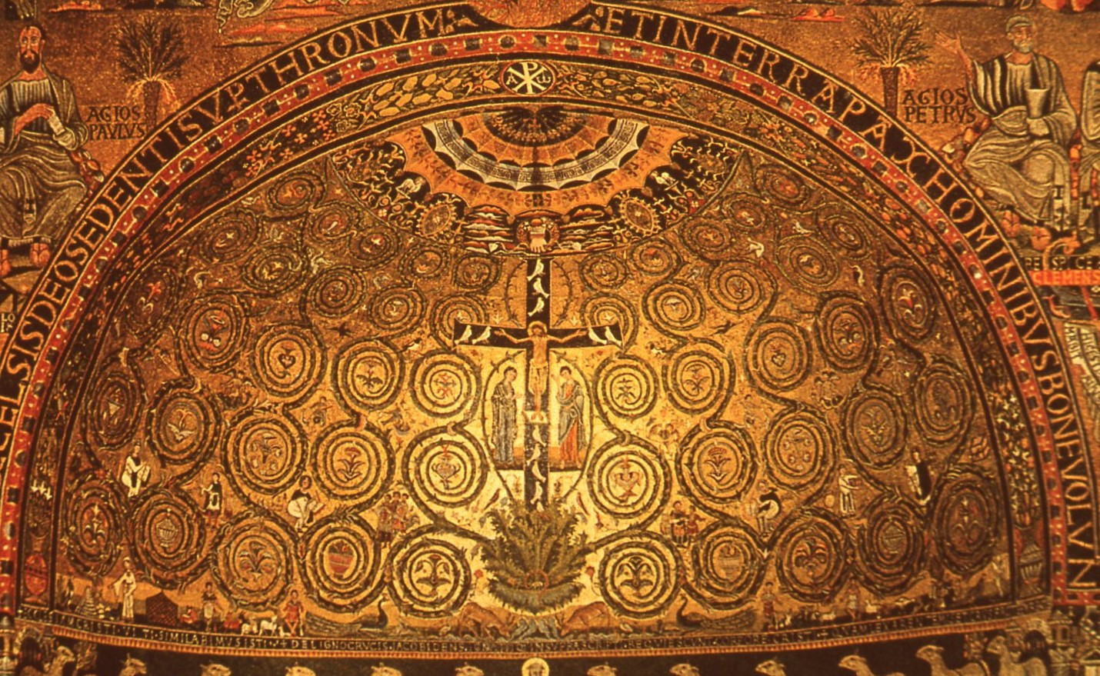
St Clemente Rome
6th century

Slide 21
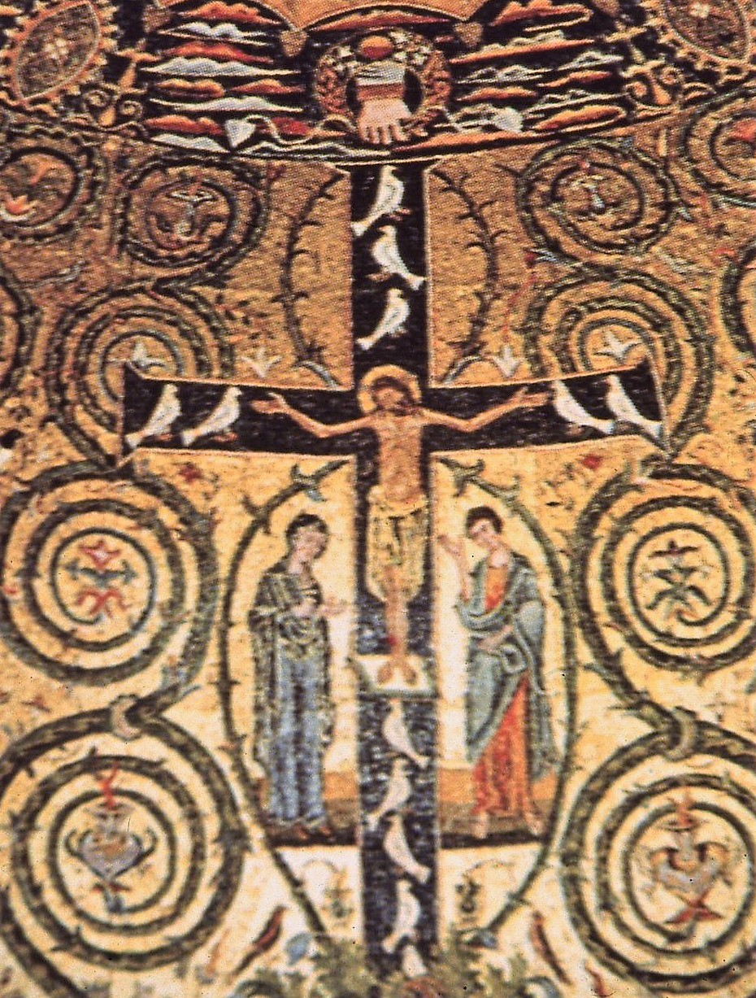
S Clemente (detail)
Floriated Cross

Slide 22
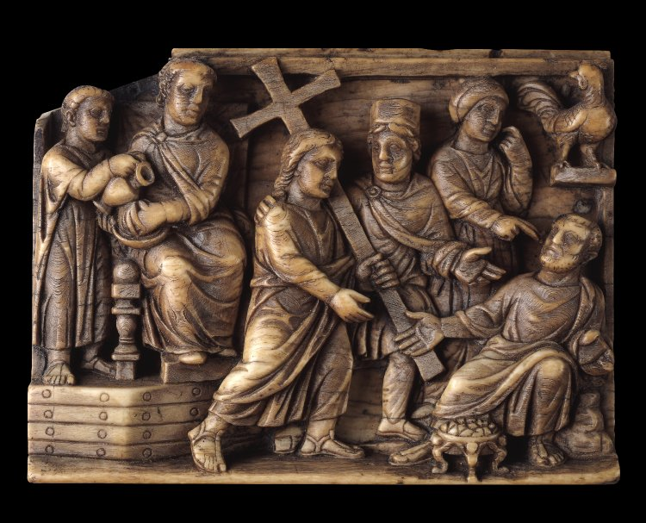
Ivory Casket
Probably Rome
c. 400
British Museum

Slide 23
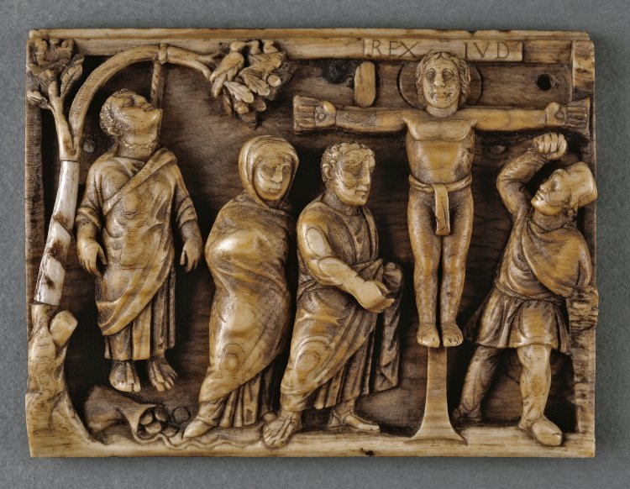

Slide 24
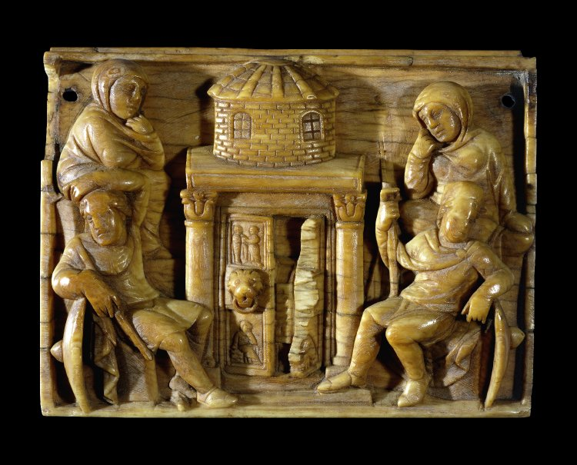

Slide 25
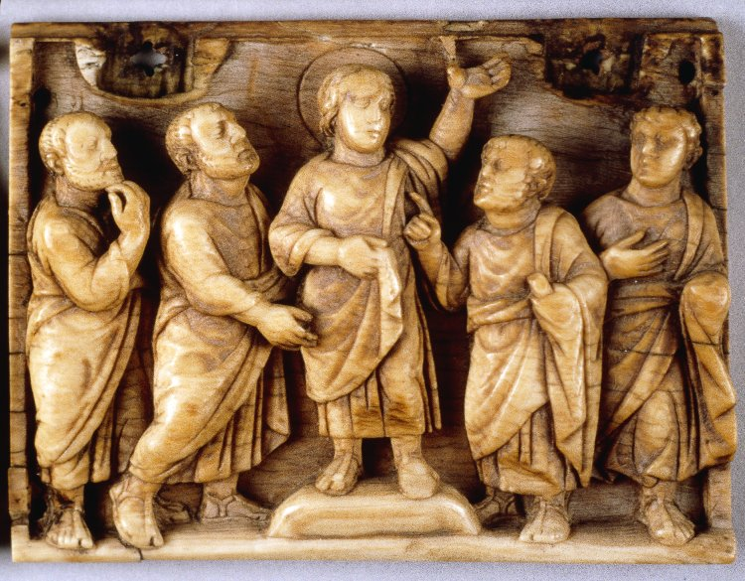

Slide 26
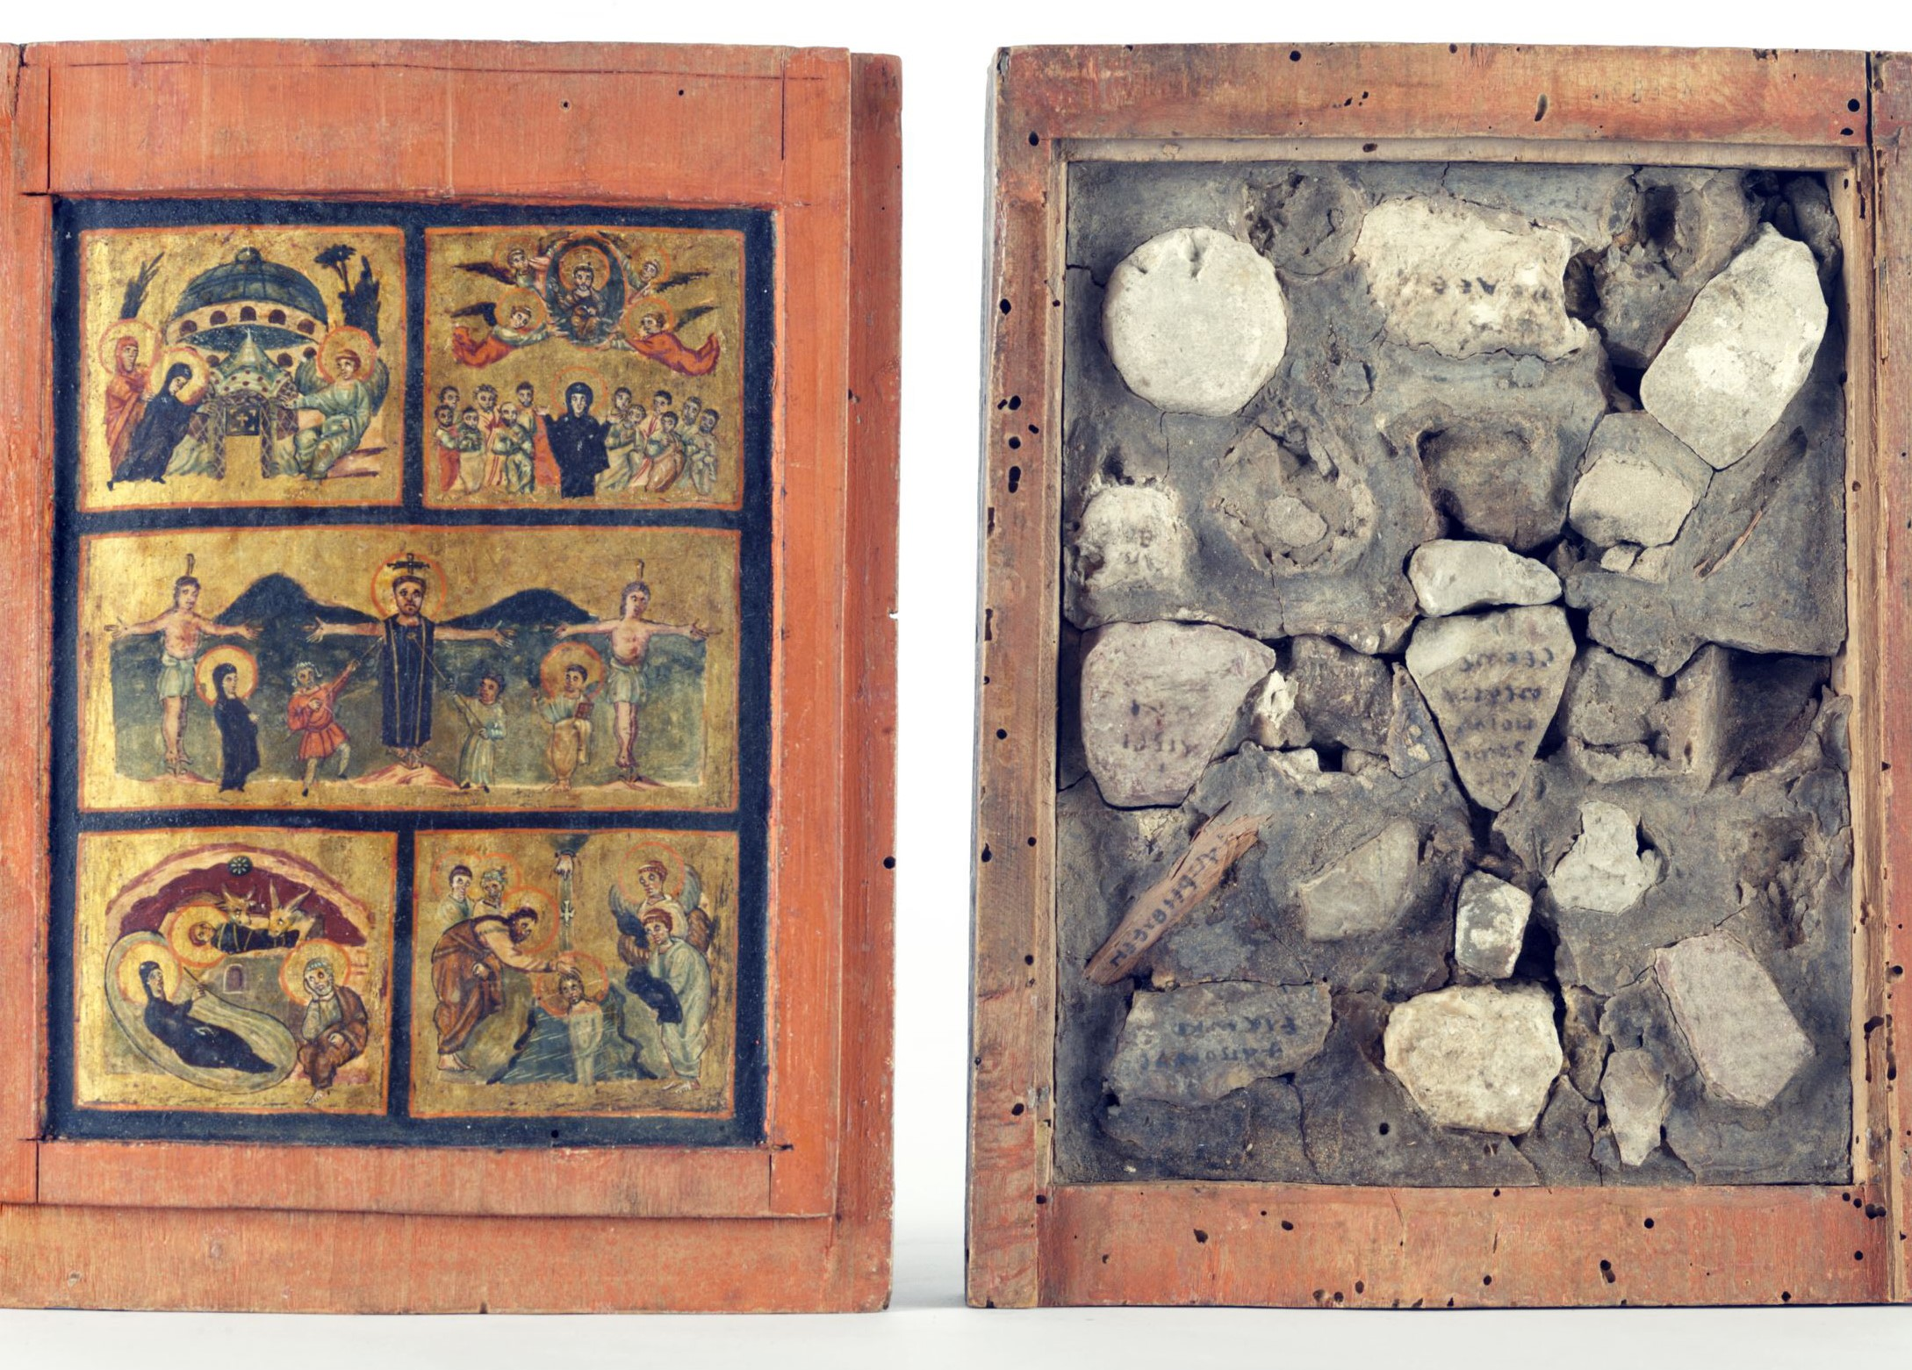
Loca Sancta Reliquary Box - lid and stones from the Holy Land – Vatican Museum 6th century

Slide 27
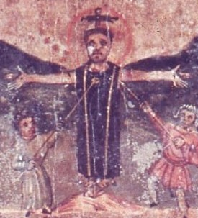
Loca Sancta - detail

Slide 28
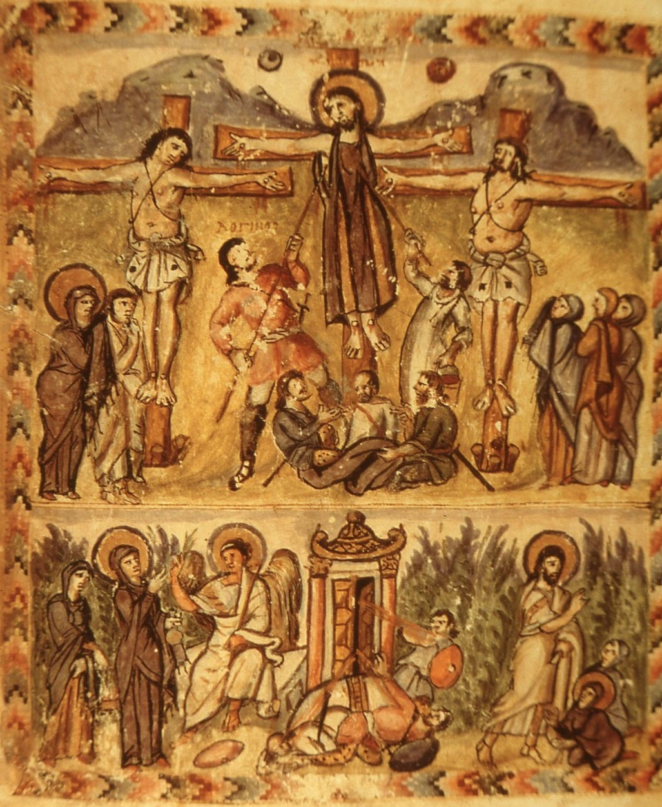
Rabulla Manuscript Mesopotamia
Medici Library, Florence
6th century

Slide 29
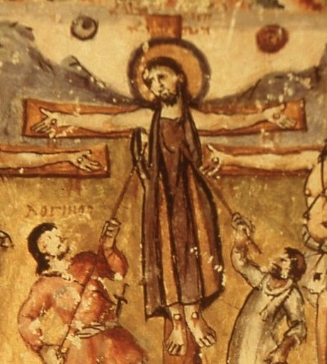
Rabulla (detail)

Slide 30
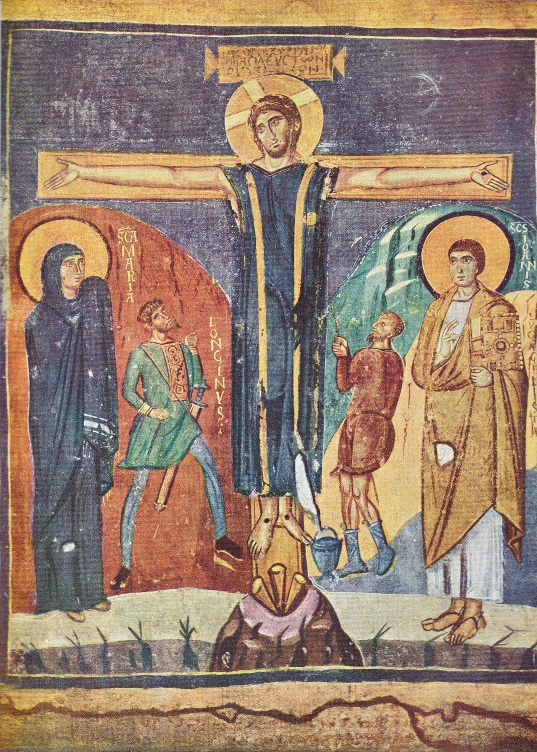
S Maria Antiqua, Rome
8th century

Slide 31
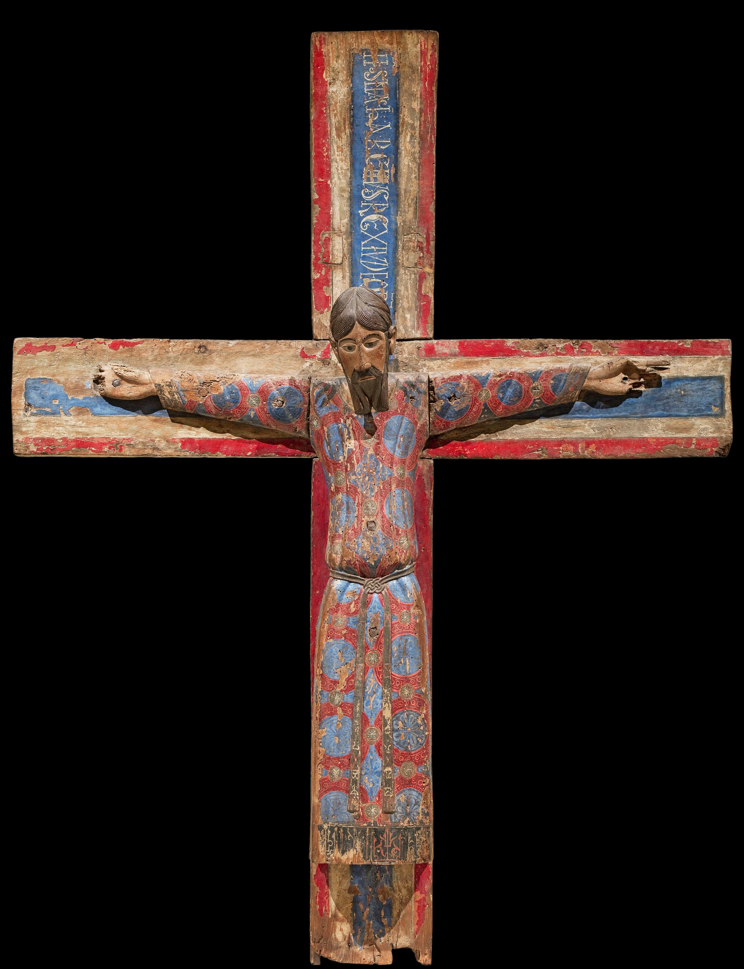
The Majesty of Christ
mid-12th century
Barcelona Museum of Catalan Art

Slide 32
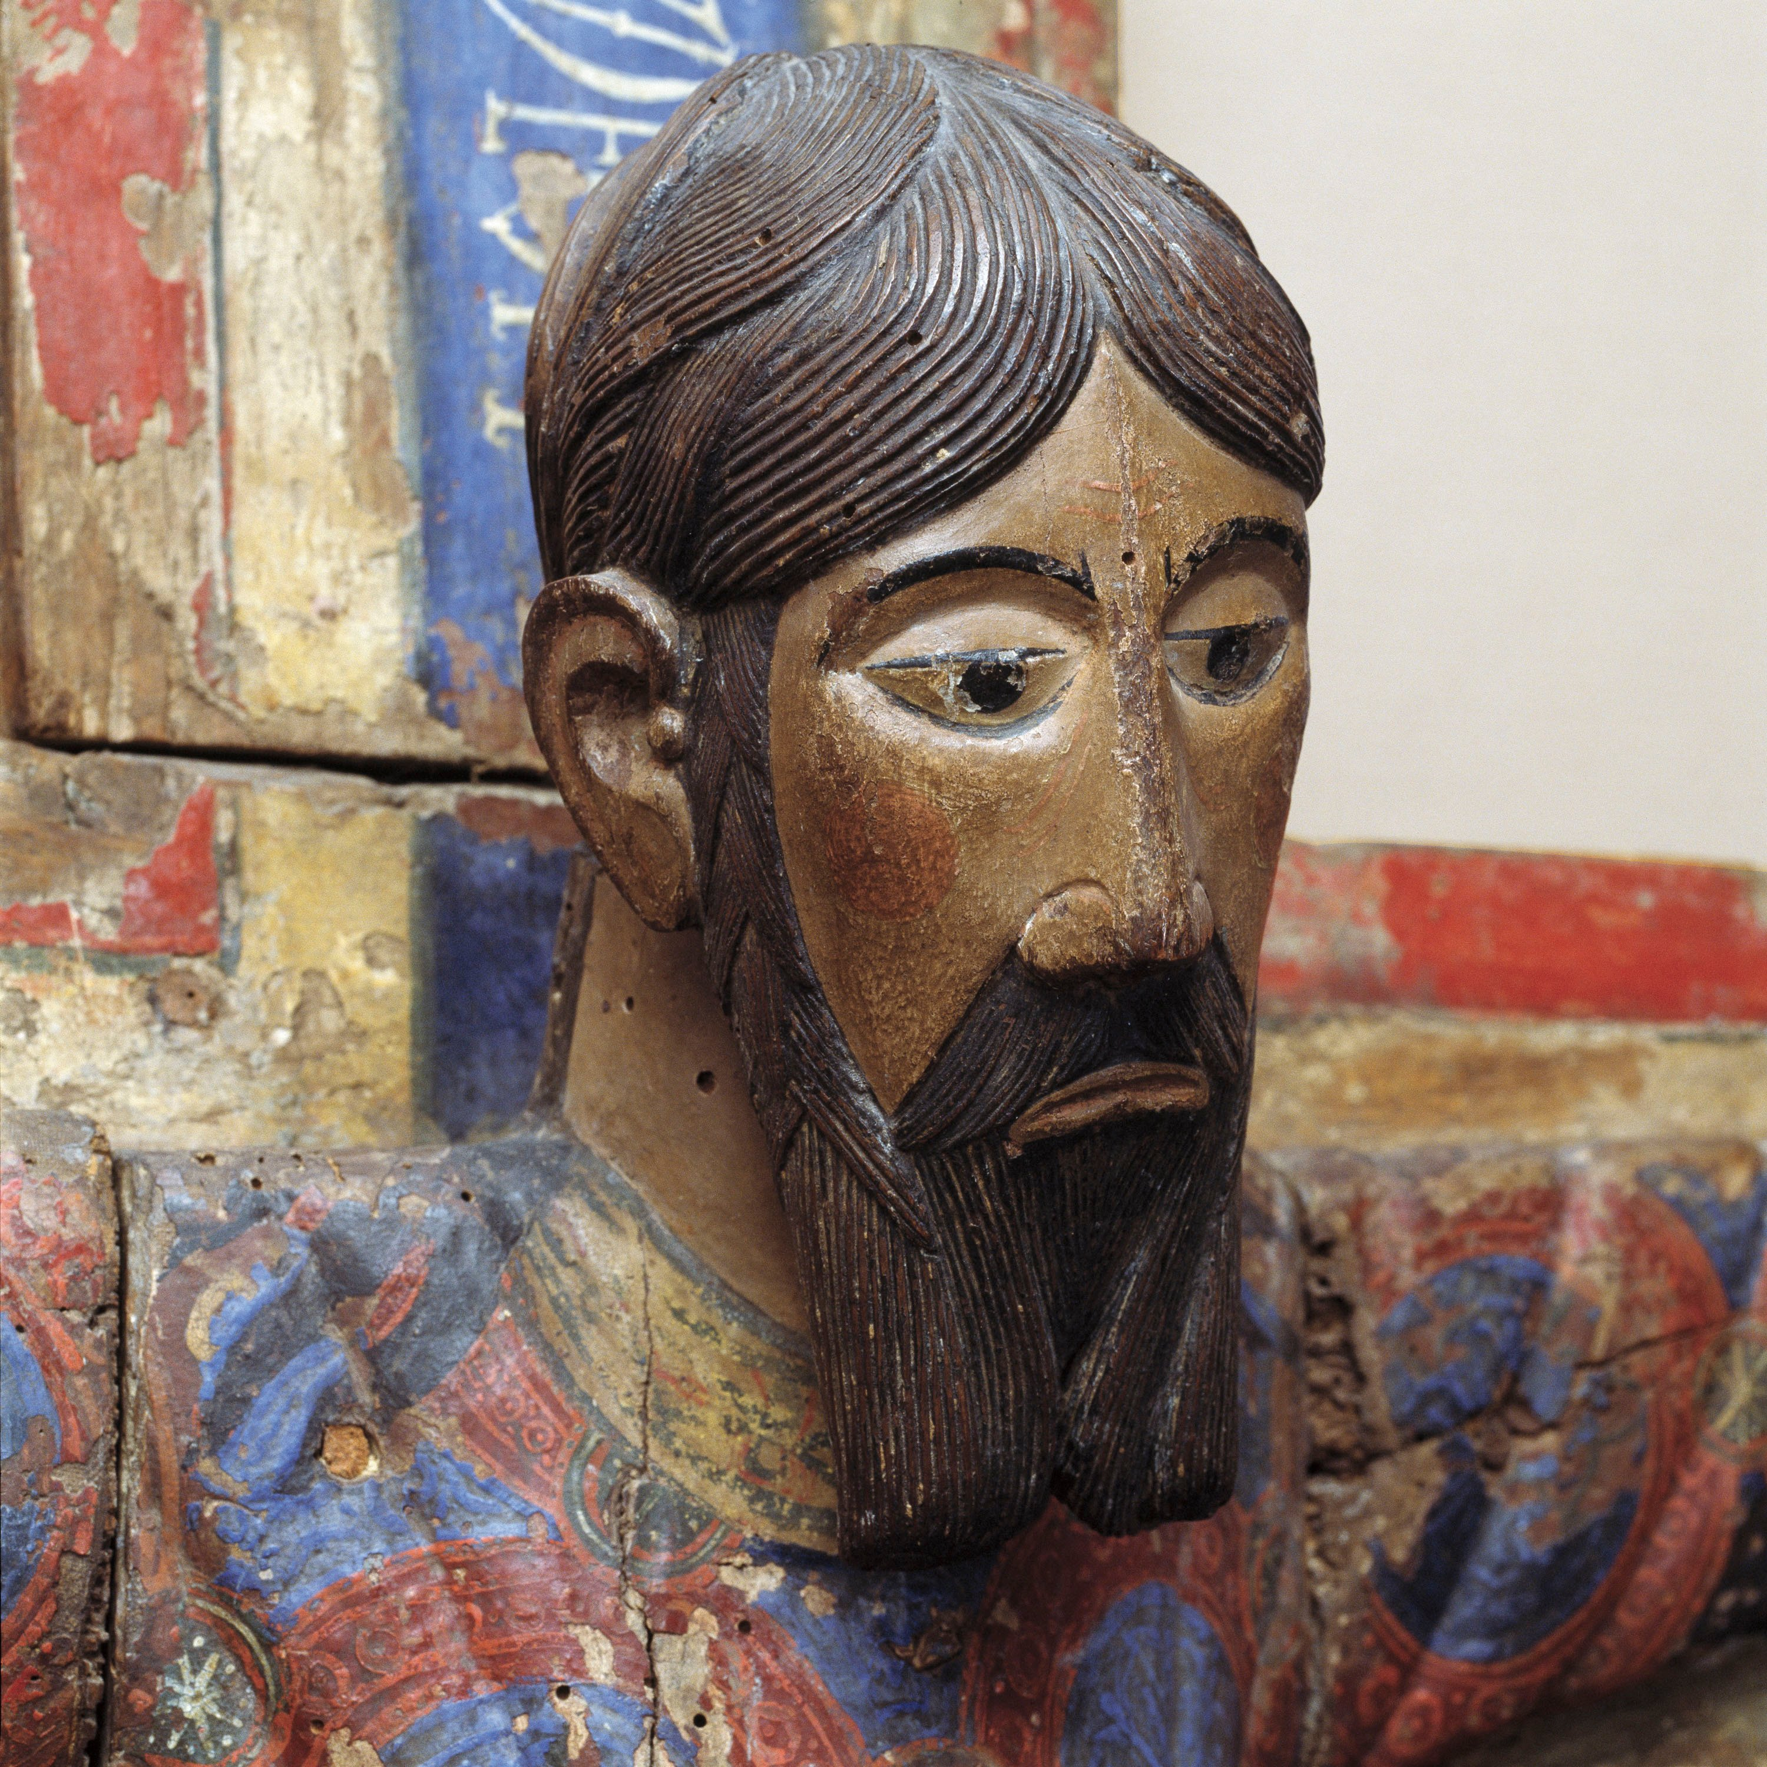
Majesty of Christ
Detail

Slide 33
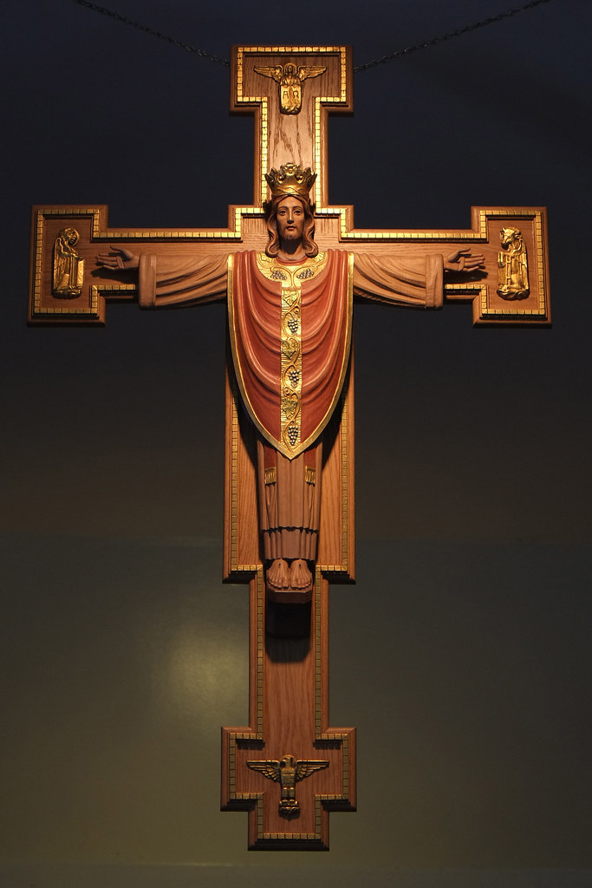
Christ as Priest on Cross
20th century

Slide 34
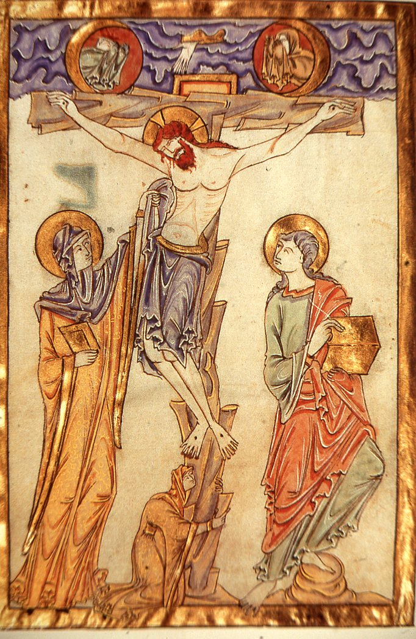
Gospel of Judith
England
c.1050

Slide 35
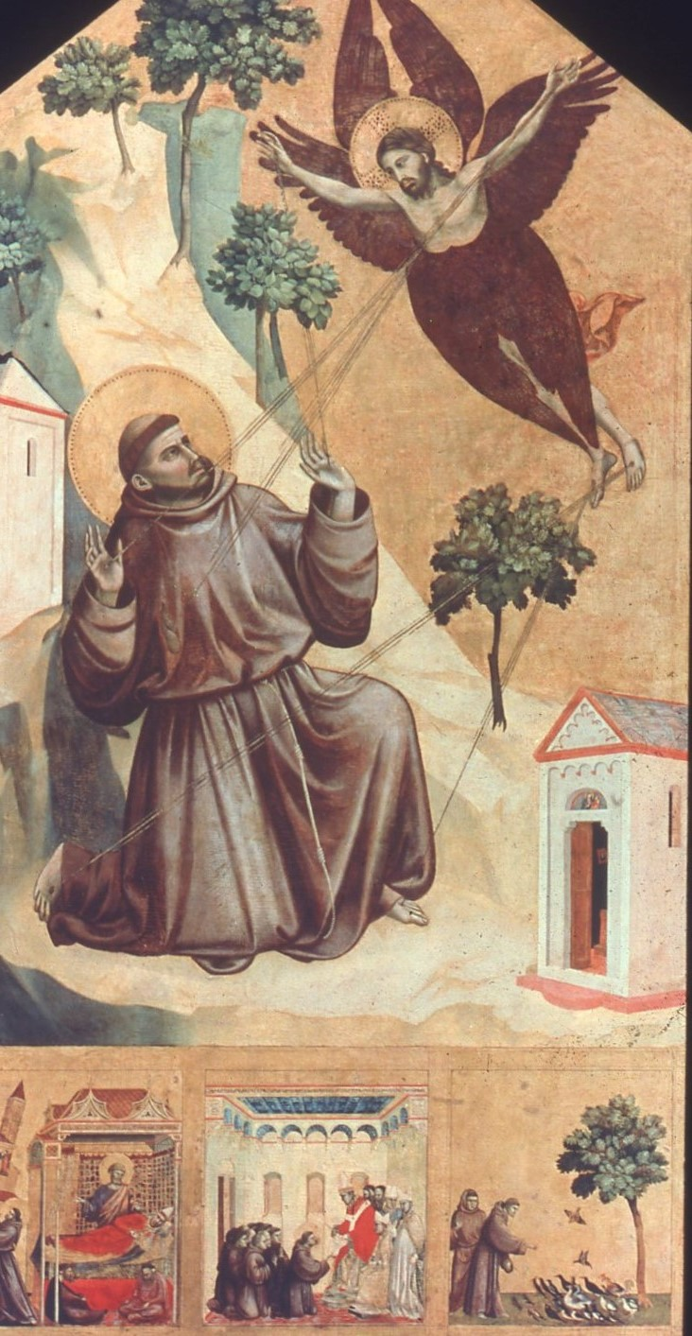
Giotto
St Francis receives the Stigmata
Louvre
1295-1300

Slide 36
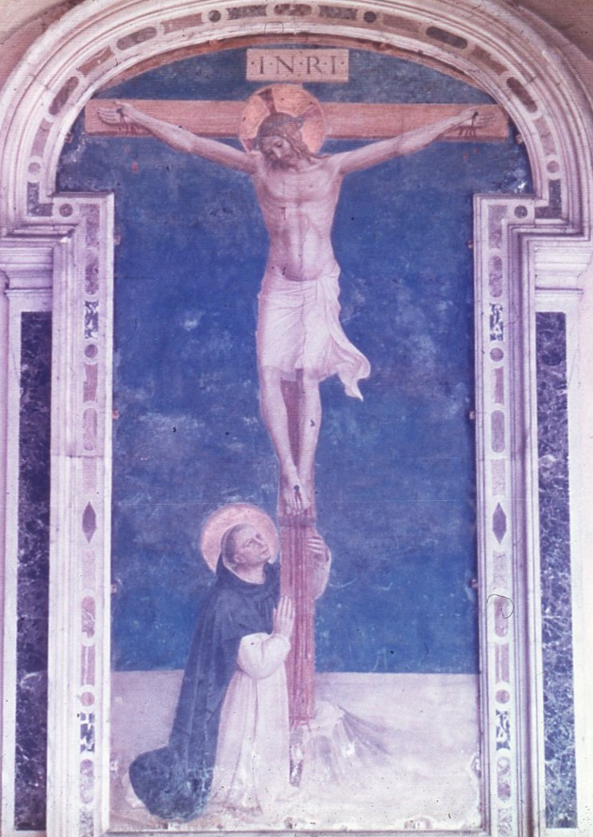
Fra Angelico
St Dominic at the foot of the Cross
San Marco, Florence 1441-3

Slide 37
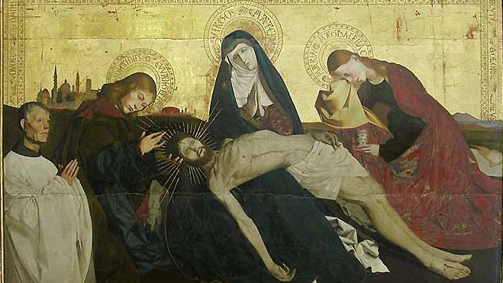
Avignon Pieta Louvre
c 1455

Slide 38
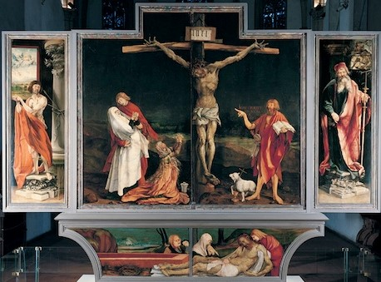
Grünewald
The Issenheim Altarpiece
Colmar
1510-1516

Slide 39
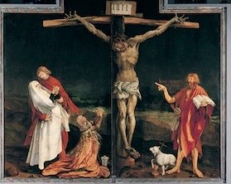

Slide 40
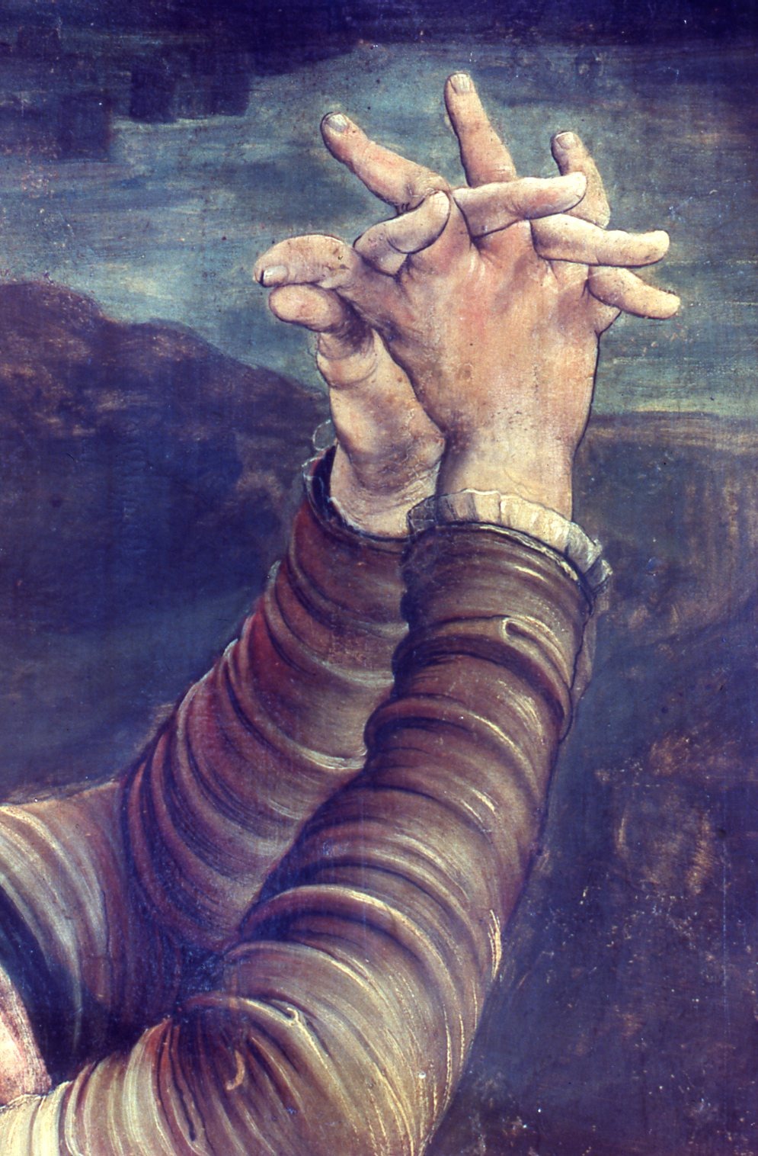
Mary Magdalen’s hands

Slide 41
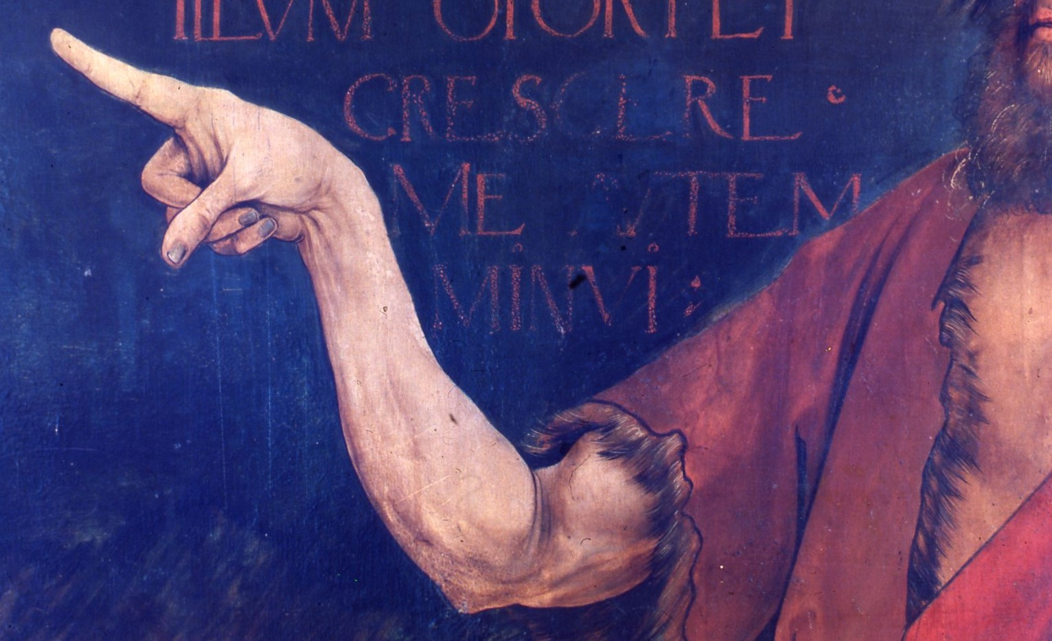
John the Baptist

Slide 42
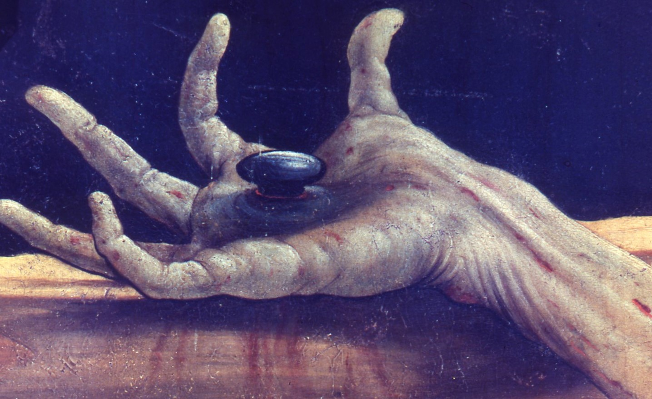

Slide 43
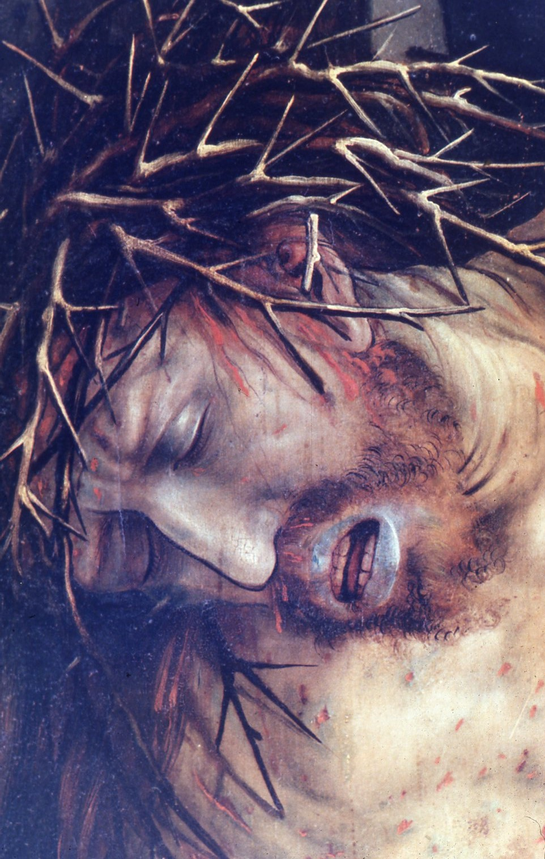

Slide 44
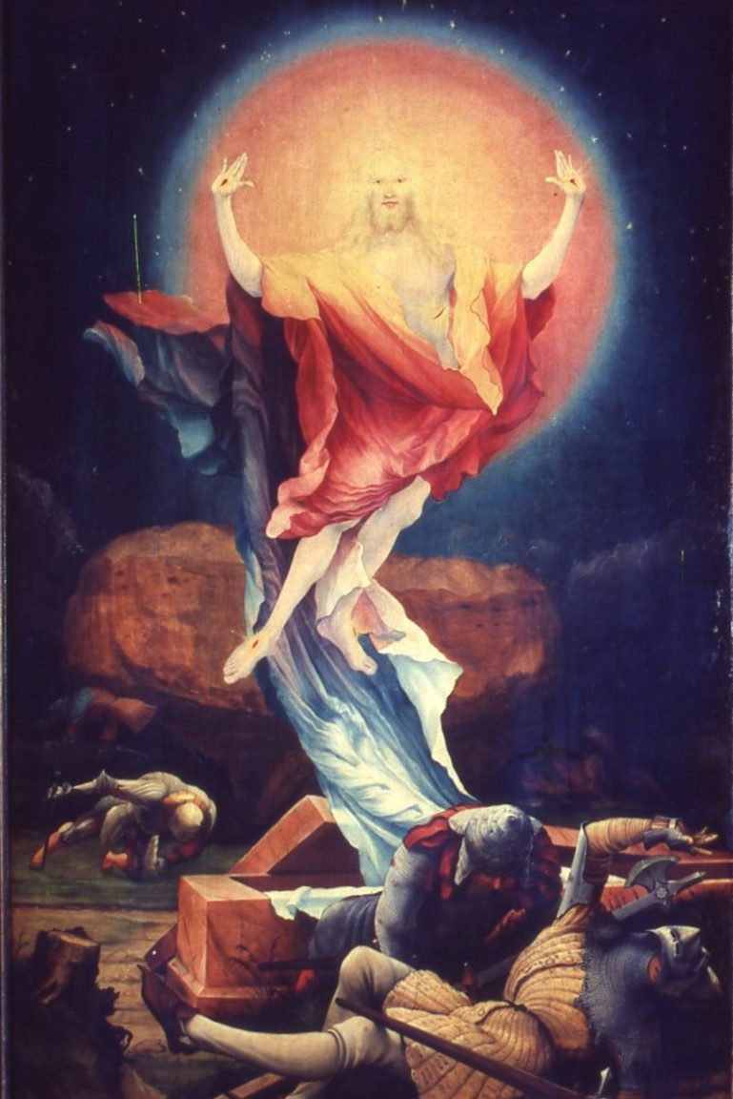

Slide 45
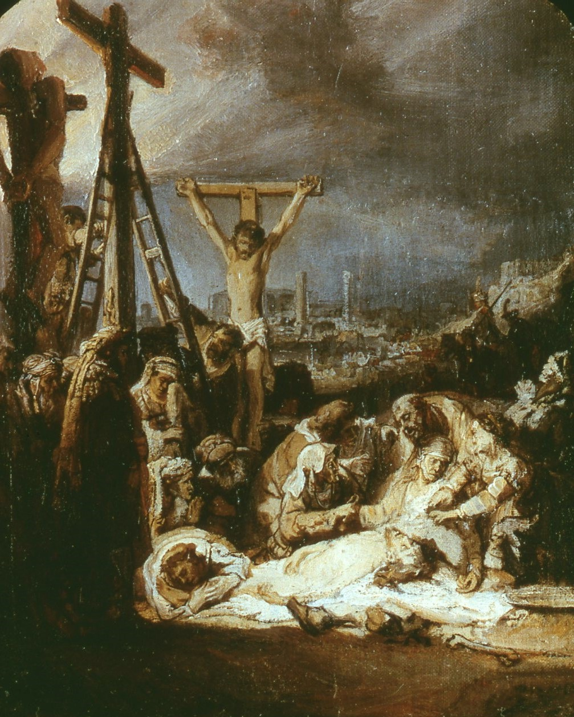
Rembrandt
Lamentation over the Dead Christ
National Gallery
c. 1635

Slide 46
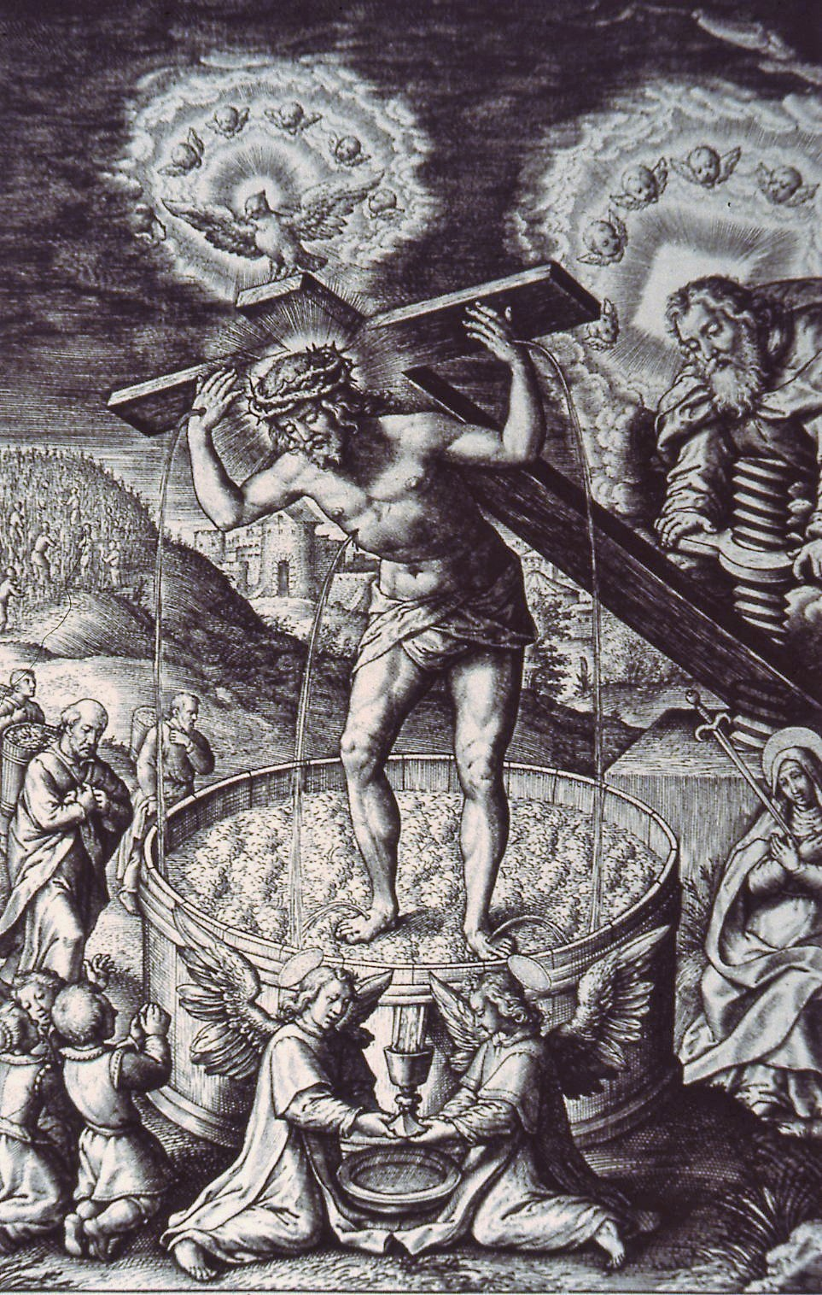
Hieronymus Wierix
Christ in the Wine Press
British Museum 1619

Slide 47
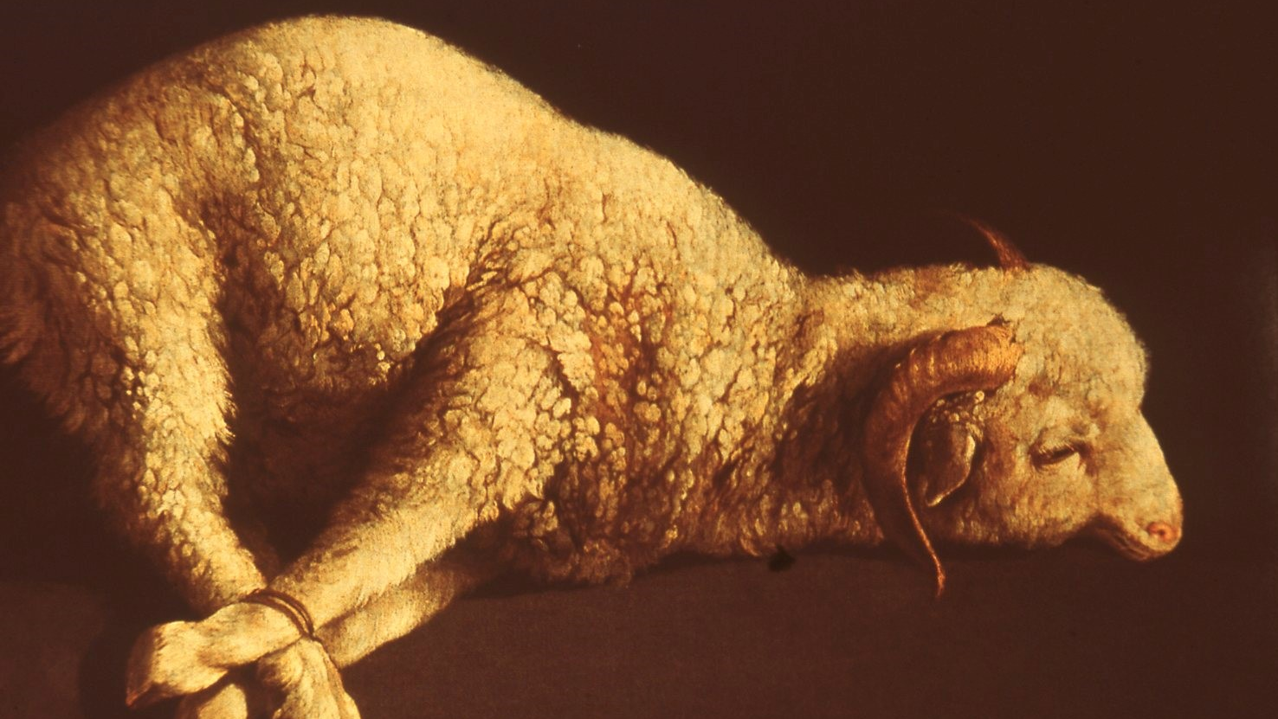
Zurburan
Agnus Dei
Prado, Madrid
1630

Slide 48
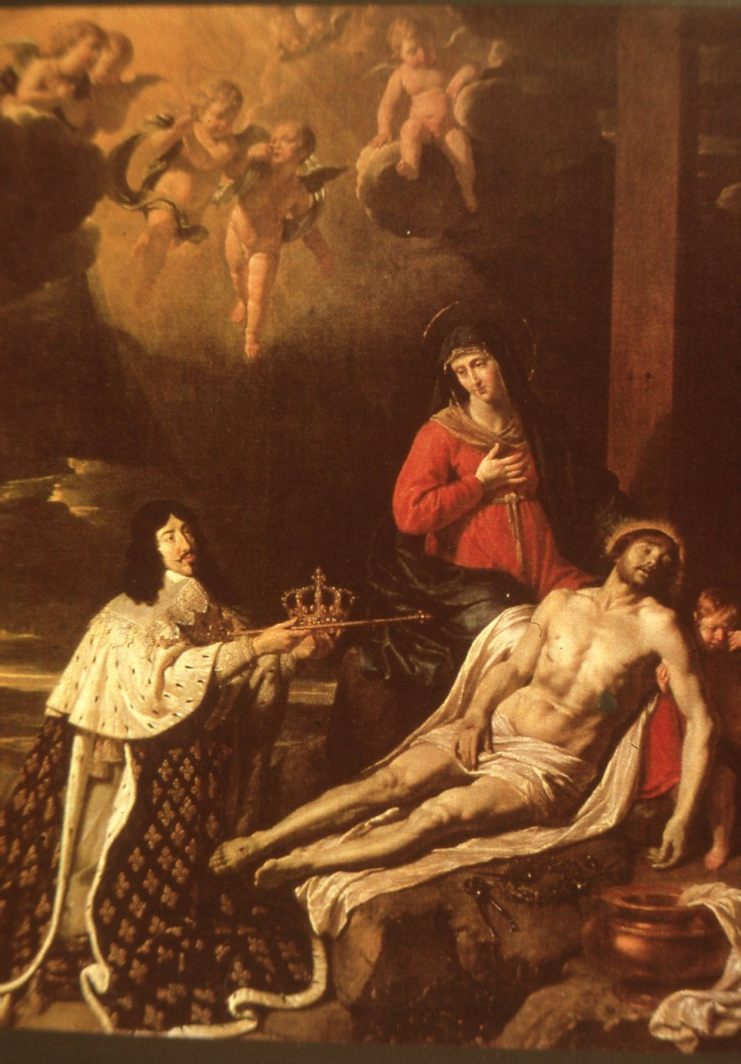
Philippe de Champaigne
The Vow of Louis XIII
Louvre
1638

Slide 49
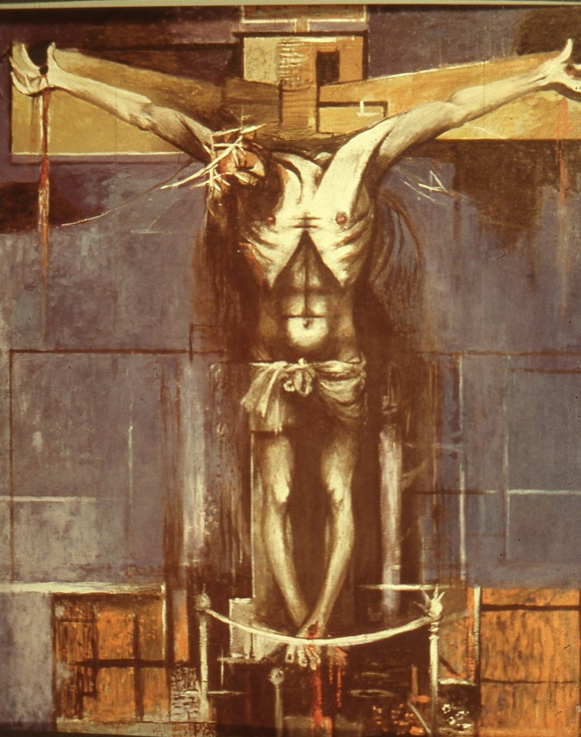
Graham Sutherland
St Matthew’s Northampton
1946

Slide 52
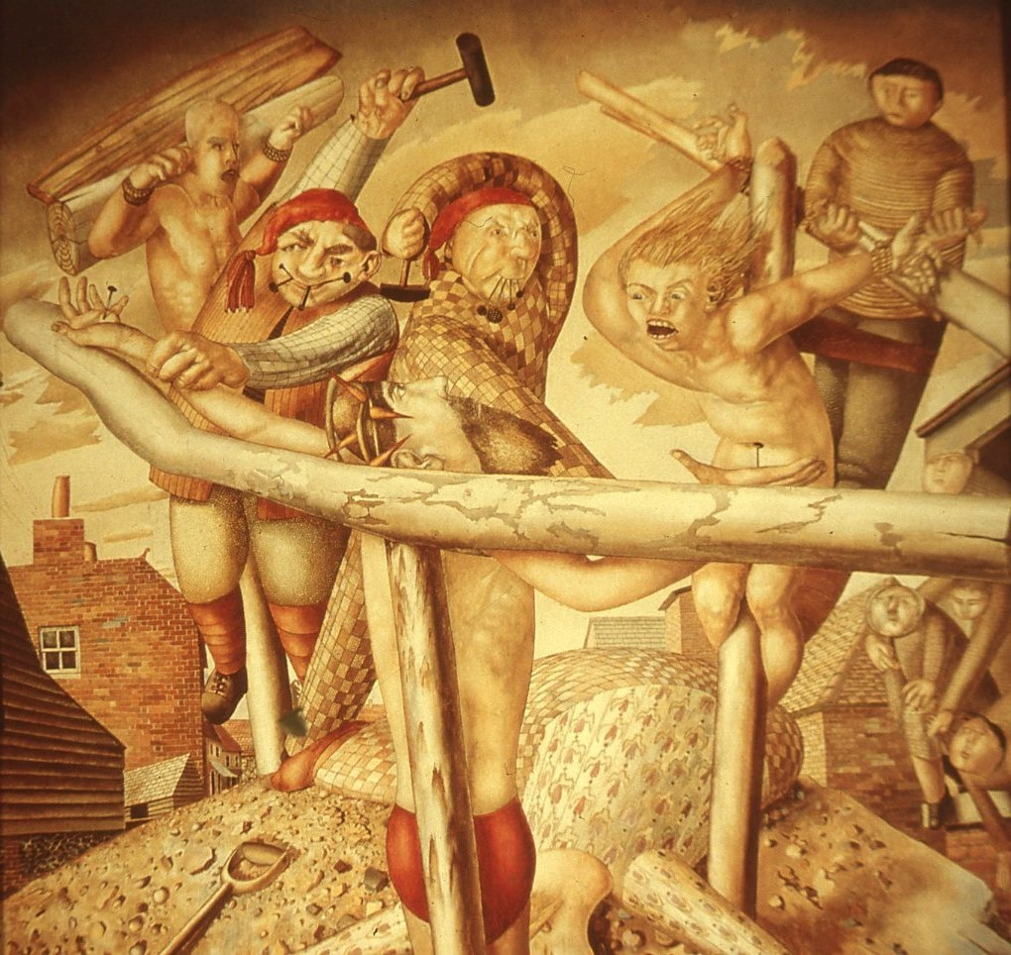
Stanley Spencer
Tate Gallery
1958

Slide 53

Stanley Spencer
Christ carrying the Cross
Tate
1920

Slide 54

Eric Gill
Westminster Cathedral
Stations of the Cross
1915

Slide 55

David Jones
Vexilla Crucis
Kettle’s Yard, Cambridge
1948

Slide 56


Slide 57

Salvador Dali
Crucifixion of St John of the Cross
Glasgow
1951

Slide 58

The Cross, The Narrow Gate
David Hayward, 2002

Slide 59

The Triumph of the Cross
Tuesday of Holy Week 2019

